Slide 1
Mobile Computing - Team Gray “On Time” Friendly pill reminder application 7.5.2019

Slide 2
Github Link
You can reach our repository by following the below link:
https://github.com/teamgray7/OnTime
Also, we have a bluetooth server implementation in the following below link:
https://github.com/teamgray7/PushButton
<number>

Slide 3
Project Description
OnTime is a friendly pill reminder application designed for elderly people.
Its main goal is to remind users to take their pills with a ‘not annoying’ alarm service.
Also, it provides statistics such as how many pills are taken on time or not during the month. This kind of information could be useful for a caretaker to track the status of elderly people.
<number>

Slide 4
Video Demonstration Link
You can reach our video of application by following the below link:
https://www.youtube.com/watch?v=Sax5OHVphtM (1.59 min)
<number>

Slide 5
The Motivation
This application was actually a suggestion made by a relative of a team member.
We talked about a few another options in the first week but we couldn’t find a better option.
So, we decided to make a wish real. 😊
<number>

Slide 6
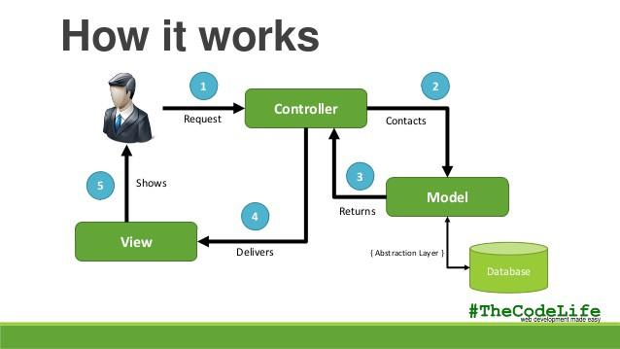
Design Process
In our implementation, we tried to follow the following designs,
Model - View - Controller architectural pattern (MVC)
Material Design rules
<number>

Slide 7
Technical Details
Our application is a feature-rich one that contains,
4 activities and 12 fragments.
1 background service that is working for the whole time.
1 list adapter and 3 helper classes for the functions
5 database tables and their interfaces
a bluetooth connection client to communicate with other devices
We are proud to present a fully-working application!
<number>

Slide 8
Problems We Encountered
During the implementation, we had some troubles on,
The alarm background service
The bluetooth connection between the server and client.
Database implementation and its interfaces
These features required us to learn and figure it how to use them. They were not basic operations.
<number>
Notes:
In the beginning, we also struggled with learning Android because it was not an easy platform.

Slide 9
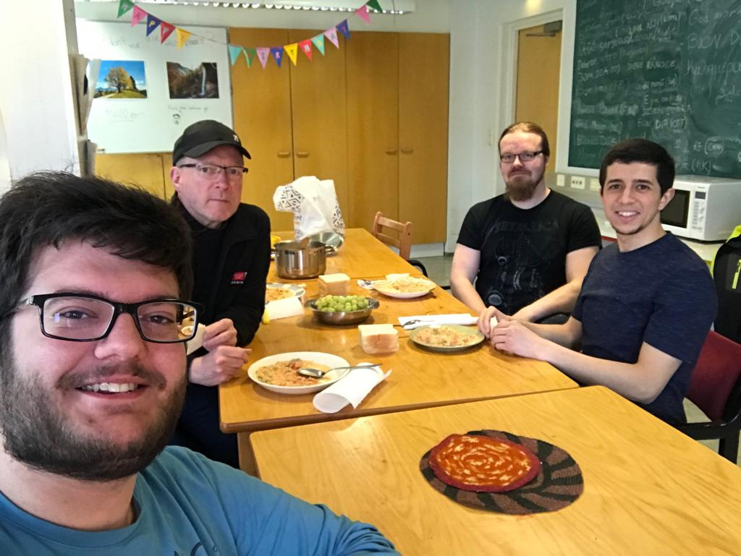
What did we good?
As the GRAY team, we believe we did a good job,
We met as a team at least once every week
Our communication was clear and good
Everybody contributed to the project
The application works perfectly!
<number>

Slide 10
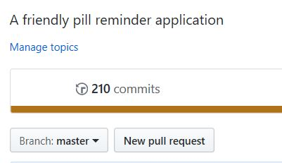
We have over 200 commits!
<number>

Slide 11
What could we improve?
Some drawbacks of our application,
The overall UI is not very efficient and appealing.
Time intervals to remind the pills are not enough. We could extend them.
<number>

Slide 12
Thank you!
Berke Esmer
Juha Paaso
Lauri Taneli Mikkonen
Dhiaa Eddine Zidane
<number>

